Slide 1
Ch10 Confidence Interval Review

Slide 2
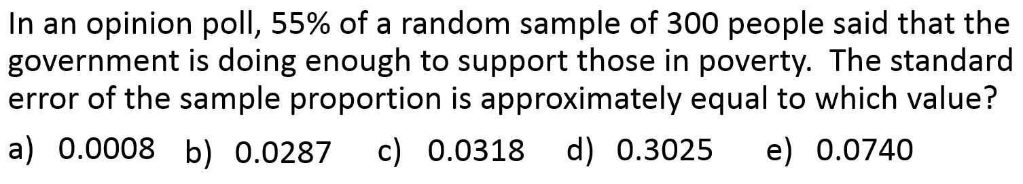
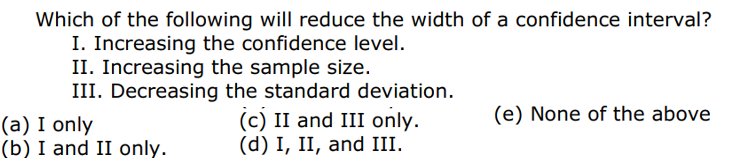
You are to construct a 90% T confidence interval for a population mean based on a sample size of 16. What is the critical value of T* you will use in constructing this interval?
a) 1.341 b) 1.753 c) 1.746 d) 2.131 e) 1.337

Slide 3
In an opinion poll, 55% of a random sample of 300 people said that the government is doing enough to support those in poverty. The standard error of the sample proportion is approximately equal to which value?
0.0008
0.0287
0.0318
0.3025
0.0740
Answer: B

Slide 4
You are to construct a 90% T confidence interval for a population mean based on a sample size of 16. What is the critical value of T* you will use in constructing this interval?
a) 1.341 b) 1.753 c) 1.746 d) 2.131 e) 1.337
Answer: B

Slide 5
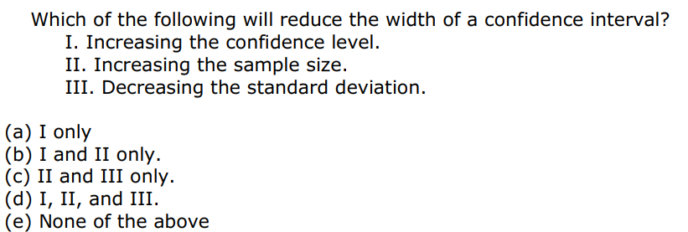
1) Increasing the confidence interval will increase the margin of error. Thus increasing the width of the C.I.
2) Increasing the sample size will reduce the margin of error. So, Yes it would reduce the width of the C.I.
3) Decreasing the standard deviation will decrease the standard error. Thus, it will also decrease the width of the c.i.
Answer “C”

Slide 6
You want to calculate a 98% confidence interval for a population mean from a sample of n=30. What is the appropriate critical t*?
a) 1.645 b) 1.699 c) 1.697 d) 2.462 e) 2.588
The weights (in pounds) of males in the US are believed to be approximately Normally distributed with mean μ. The mean height of a random sample of 3 American adult males is found to be ‾x=190” and the SD S_{x}=27.84. What is the standard error of ‾ x?
a) 190 b) 27.84 c) 22.73 d) 16.07 e) 13.13
A poll plans to ask a random sample of adults whether they attended a religious service in the past week. How large a sample would be required to obtain a margin of error 0.01 in a 99% confidence interval for the population proportion who would say that they attended a religious service?
a) 129 b) 16,588 c) 6,766 d) 258 e) 66,358

Slide 7
You want to calculate a 98% confidence interval for a population mean from a sample of n=30. What is the appropriate critical t*?
a) 1.645 b) 1.699 c) 1.697 d) 2.462 e) 2.588
Answer: D

Slide 8
The weights (in pounds) of males in the US are believed to be approximately Normally distributed with mean μ. The mean height of a random sample of 3 American adult males is found to be ‾x=190” and the SD S_{x}=27.84. What is the standard error of ‾ x?
a) 190 b) 27.84 c) 22.73 d) 16.07 e) 13.13
The population standard deviation is not given. So we would have to perform a T-procedure to find the standard error
Answer: “D”

Slide 9
A poll plans to ask a random sample of adults whether they attended a religious service in the past week. How large a sample would be required to obtain a margin of error 0.01 in a 99% confidence interval for the population proportion who would say that they attended a religious service?
a) 129 b) 16,588 c) 6,766 d) 258 e) 66,358
NOTE: The population proportion is not given. So we will assume that p=0.5
The critical z-score for a 99% Conf. Interval is INVNOrm(0.005) = 2.575829
Answer: B

Slide 10
A lab supply company sells pieces of pine wood 4” long and 1.5inch² for force experiments in science classes. From experience, the strength of these pieces of wood follows a normal distribution with SD 3000pounds. How large of a sample is needed to estimate the mean load needed to apart these pieces of wood to within 1000pounds with 95% confidence
a) 571 b) 24 c) 7 d) 5 e) 35
The survey in the previous question was conducted by calling cellphones, and those conducting the survey are concerned about the possibility of undercoverage, since some people do not own a cellphone or only have a landline. Which of the following is the best way for them to correct this source of bias?
Throw this sample out and start over again with a better sampling method
Use a higher confidence level, such as 99%
Use a lower confidence level, such as 80%
Us a t-interval instead of a z-interval
Take a larger sample

Slide 11
A lab supply company sells pieces of pine wood 4” long and 1.5inch² for force experiments in science classes. From experience, the strength of these pieces of wood follows a normal distribution with SD 3000pounds. How large of a sample is needed to estimate the mean load needed to apart these pieces of wood to within 1000pounds with 95% confidence
a) 571 b) 24 c) 7 d) 5 e) 35
The question is asking for a sample size needed so that the margin of error is within 1000pounds.
Population standard deviation is 3000pounds.
For a 95% C.I., the z-critical score is: INVNORM(0.025)=1.95996
Answer “E”

Slide 12
The survey in the previous question was conducted by calling cellphones, and those conducting the survey are concerned about the possibility of undercoverage, since some people do not own a cellphone or only have a landline. Which of the following is the best way for them to correct this source of bias?
Throw this sample out and start over again with a better sampling method
Use a higher confidence level, such as 99%
Use a lower confidence level, such as 80%
Us a t-interval instead of a z-interval
Take a larger sample
Garbage IN Garbage OUT!!!
IF there is bias in your sample, then nothing you do can correct his bias.
Answer: A

Slide 13
Which of the following would result in the narrowest confidence interval?
A) Small sample size and 95% confidence
B) small sample assize and 99% confidence
C)Large sample size and 95% confidence
D) Large sample size and 99% confidence
E) This cannot be answered without knowing an appropriate standard deviation
Changing from a 90% confidence interval estimate for a population proportion to a 99% confidence interval estimate, with all other things being equal:
a) Increases the interval size by 9%
b) decreases the interval size by 9%
c) Increases the interval size by 57%
d) decreases the interval size by 57%
e)This question cannot be answered without knowing the sample size

Slide 14
Which of the following would result in the narrowest confidence interval?
A) Small sample size and 95% confidence
B) small sample assize and 99% confidence
C)Large sample size and 95% confidence
D) Large sample size and 99% confidence
E) This cannot be answered without knowing an appropriate standard deviation
Larger sample size will reduce Confidence Interval
A smaller confidence will reduce the z-critical score, thus reducing the margin of error.
Answer: “C”

Slide 15
Changing from a 90% confidence interval estimate for a population proportion to a 99% confidence interval estimate, with all other things being equal:
a) Increases the interval size by 9%
b) decreases the interval size by 9%
c) Increases the interval size by 57%
d) decreases the interval size by 57%
e)This question cannot be answered without knowing the sample size
Find the z-critical score for both confidence intervals:
INVNORM(0.05) = 1.64485
INVNORM(0.005) = 2.5758
Percentage increase = (2.5758 – 1.64484)/1.64484
=0.5659930
The width of the confidence interval will increase by 57%
Answer “C”

Slide 16
The report of a sample survey of 1,014 adults says “With 90% confidence, between 37% and 44% of all Canadians are married”. What does the phrase 90% confidence mean?
We can be 90% confident that the method used to get the interval always gives the right answer
We are 90% confident that the true proportion of Canadians that are married is between 37% to 44%.
The probability that between 37% and 44% of the Canadian population that is married is about 90%.
The method used to get the interval from 37% to 44%, when used over and over, produces intervals which include the true population percentage about 90% of the time
95% of all Canadians will be married between 37% and 44% of the time
We are confident in the method used to create the confidence interval, “Not” confident in the interval. So the best answer is “D”

Slide 17
Johnny wants to estimate the proportion of all students that wear a watch regularly. He stands at the front door for fifteen minutes on a weekday morning and flips a coin each time a student arrives. If the coin comes up heads, he asks them if they were a watch. After fifteen minutes, he has 33 responses and 21 of them wore a watch. Which condition for constructing a Confidence interval for a proportion has the student failed to satisfy?
Not every student comes in from the front door.
He is sampling based on convenience leading to a Bias Sample.
Answer: D

Slide 18
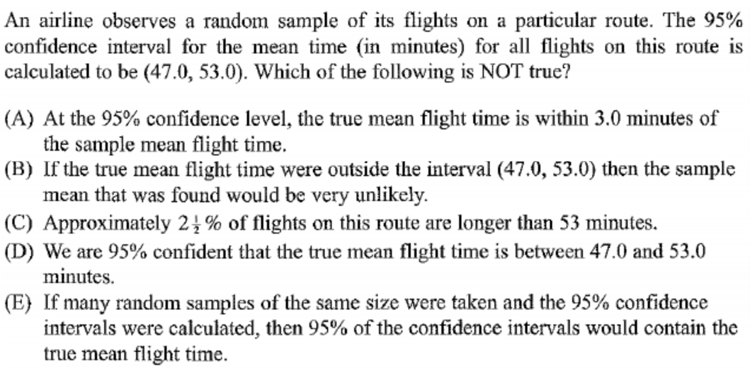
Let’s dissect each of the responses:
C) This one is saying that with a 95% confidence, each tail would then be 2.5%. So 2.5% of flights would be longer than 53minutes. This would be true if the sample mean was equal to the parameter mean. Unfortunately, they may be different and this statement would be false
D) We are confident in the method but not the interval. However, most books would accept this interpretation.
b) We have 95% confidence in the method that we used to create this C.I. So the chances that the parameter was outside of this Confidence Interval should be unlikely.
E) This one is definitely true….. It’s the definition of a confidence interval
a) From our confidence interval, the margin of error is plus or minus 3 minutes. So 95% of all samples will be within 3minutes. TrUE

Slide 19
A 90% confidence interval for the average amount spent on books by a freshman at a major university is $352+2. How would the margin of error of a 95% C.I. based on the same sample compare with the 90% interval?
It would be smaller, because it omits 5% of the possible samples instead of 10%
It would be the same, because the sample is the same
It would be larger, because higher confidence requires a larger margin of error
Can’t tell, because the margin of error varies from sample to sample
Can’t tell, because it depends on the size of the population
Answer: C, because larger confidence would require a larger margin of error

Slide 20
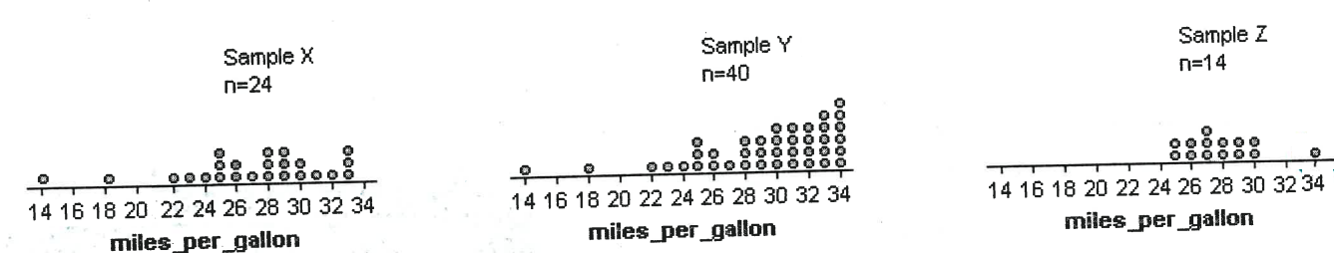
In checking conditions for constructing confidence intervals for a population mean, it’s important to plot the distribution of sample data. Below are dot plots describing samples from three different populations. For which of the three samples would it be safe to construct a t-interval?
Sample X only b) Sample Y only c) Sample Z only
d) Samples Y and Z e) None of the samples
When plotting a sample, our goal is to check if there’s evidence to suggest that the population is not normal: All three samples have outliers, suggesting that the population is skewed.
If the population is skewed, then we want our sample size to be bigger than 30. According to the CLT, if sample sizes are greater than 30 then the distribution of sample means would be normal
Answer: “B”

Slide 21
The Cad Forest service is considering additional restrictions on the number of cars allowed to enter BC rain forest. To assess public reaction, the service asks a random sample of 150 visitors if they favor the proposal. Of these, 89 say “Yes”.
State the conditions requires to create C.I.
Construct a 99% confidence interval to estimate the proportion of all visitors who support the restrictions
Write a concluding sentence in context to describe what the C.I. means
First thing we do is check if we are performing a Z-interval based on mean, T-interval, or 1 Sample Proportion Z- Interval
Sample size is 150 with 89 Yes. This would be a 1 sample Proportion Z-interval (10.3)
a) Condition: SRS – the sample is stated to be a random sample
Normality - np and nq both need to be greater or equal to 10
Independence: Since are we are sampling without replacement N>10n
There are more than 1500 people in the public…. Independence is satisfied.

Slide 22
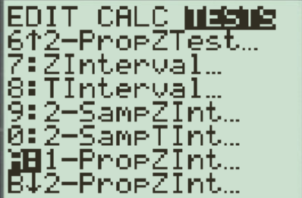
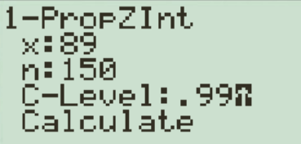
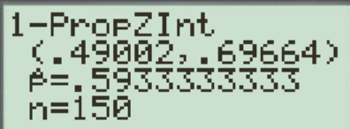
B) To construct a 99% confidence interval, use a Ti83. (Fastest way)
InvNORM(0.005) = 2.575829
99% Confidence Interval is 49.002% to 69.664%
C) We are 99% confidence that the true population proportion that is in favor of adding restrictions on cars entering BC rain forests is between 49% to 69.6%.
AP Interpretation: We are confident that the method we used to create the confidence interval of 49% to 69.6% will capture the true population proportion 99% of the time.

Slide 23
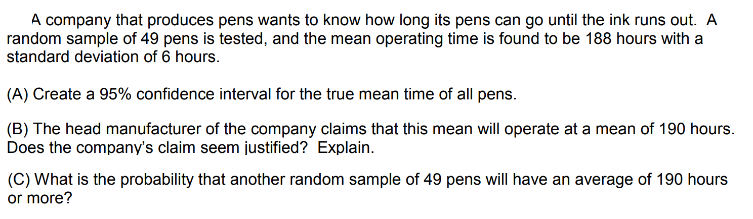
First thing we do is check if we are performing a Z-interval based on mean, T-interval, or 1 Sample Proportion Z- Interval
Sample mean of 188hours and sample standard deviation of 6 hours are given. No population standard deviation. This would then be a T-Interval.
Before we find the Confidence interval, check if the conditions are met:
SRS – IT is stated that the sample is a random sample
Normality : Sample size is greater than 30, n=49, so the distribution of sample mean would be normal
Independence: We would assume that the population of interest has more than 490 pens…

Slide 24
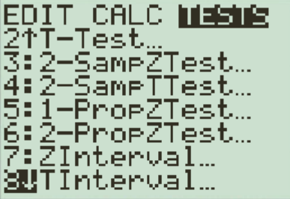
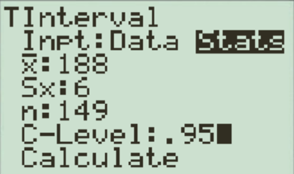
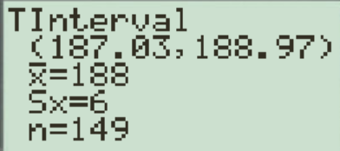
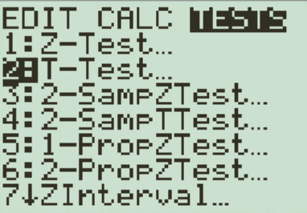
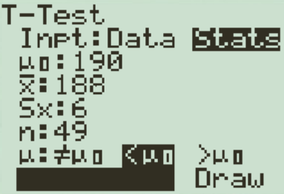
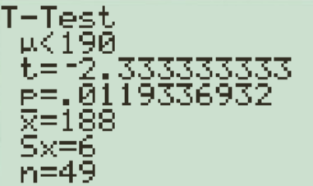
TO Create a confidence interval, use a Ti83
Our 95% confidence interval is between 187.03 hours to 188.97 hours.
b) The claim that the true population mean is 190 hours is unlikely since it is outside of our 95% confidence interval.
Suppose that the mean was 190hours, what is the probability that we would get our sample of 188hours? This would require a T-test, (11.2)
If the true population mean was 190, the probability that we would get a sample of 188hours would be about 1.19%. Therefore, we have evidence to suggest that the parameter mean to be 190hours is unlikely.

Slide 25
Since we don’t have the population mean, I’m not sure how we can calculate the probability of getting a certain mean from a sample.
However, from our 95% confidence interval of 187.03 hours to 188.97 hours, it suggests that getting a mean of 190 hours would be less than 2.5%

Slide 26
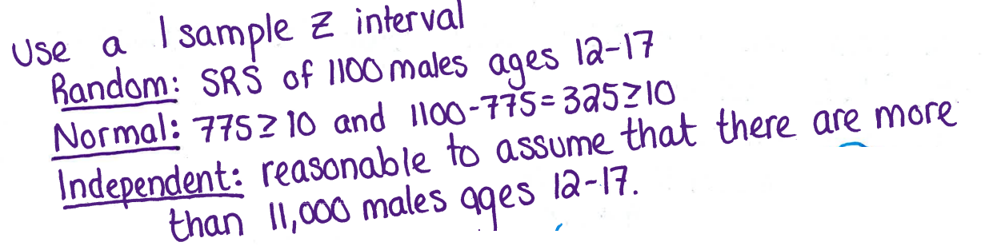
A SRS of 1100 males aged 12 to 17 in BC were asked whether if they play computer games on a nightly basis. 775 said that they did. We want to use this information to construct a 95% confidence interval to estimate the proportion of all BC males aged 12 to 17 who play computer games in a nightly basis.
a) Check the conditions required to construct a 95% C.I.
b) Construct a 95% confidence interval to estimate the proportion of 12 to 17 year old males who play computer games every night.

Slide 27
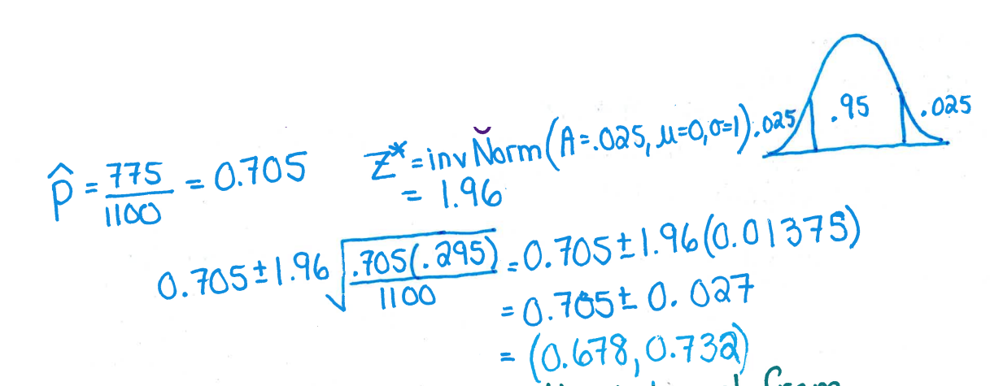
We are 95% confident that the interval from 0.687 to 0.732 captures the actual proportion of all males aged 12 to 17 that play computer games on a nightly basis.

Slide 28
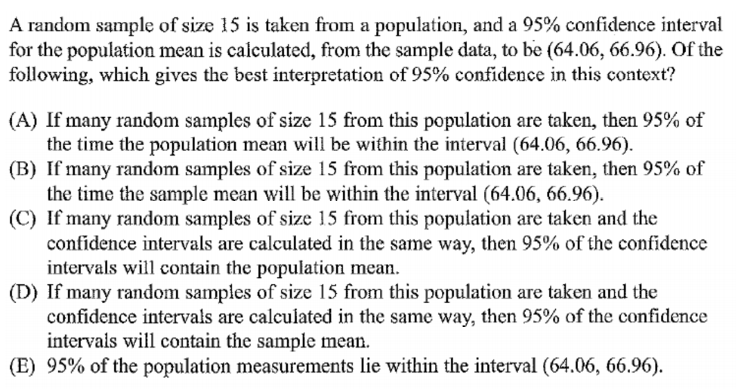
Answer: “C”

